Slide 1
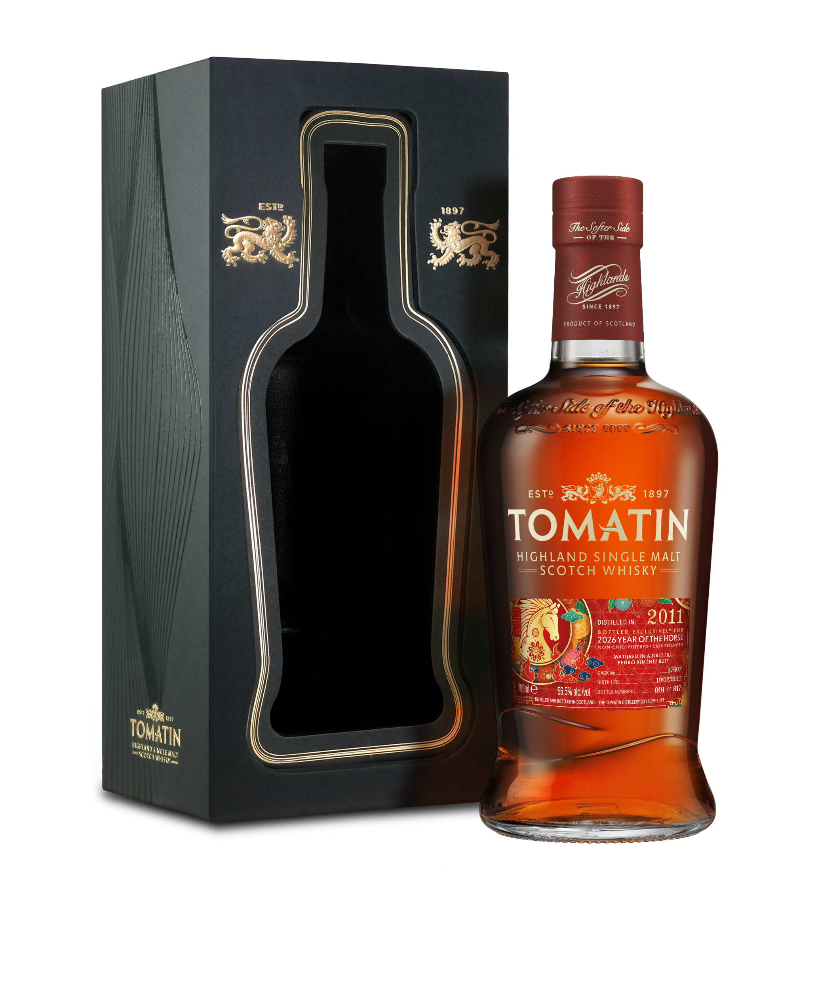
Tomatin Year of the Horse 2026
Cask 37607
This 2011 vintage has been bottled to celebrate the 2026 Lunar New Year, the Year of the Horse.
The nose opens with a burst of orange zest and dried cranberries before moving in a sweeter direction with notes of honeycomb and candy floss. Throughout, notes of cinnamon, tiramisu, mulled wine, and even jalapeno leap out and pull the nose in different directions. There’s something new to be found every time you pick up the glass.
The taste is a bit more structured than the nose suggests, but still full of varied flavours like candied almonds, toffee apples, sultanas, and salted liquorice. The finish is long and round with lingering baking spice.
First Fill Pedro Ximénez Sherry Butt
ABV Strength: 56.5% alc./vol.
Key Details:
A global release to celebrate the Chinese Zodiac Year of the Horse
Only 817 bottles available
Numbered bottles
Distilled on 10 February 2011
Non-Chill Filtered
Natural strength and colour.

