Slide 1
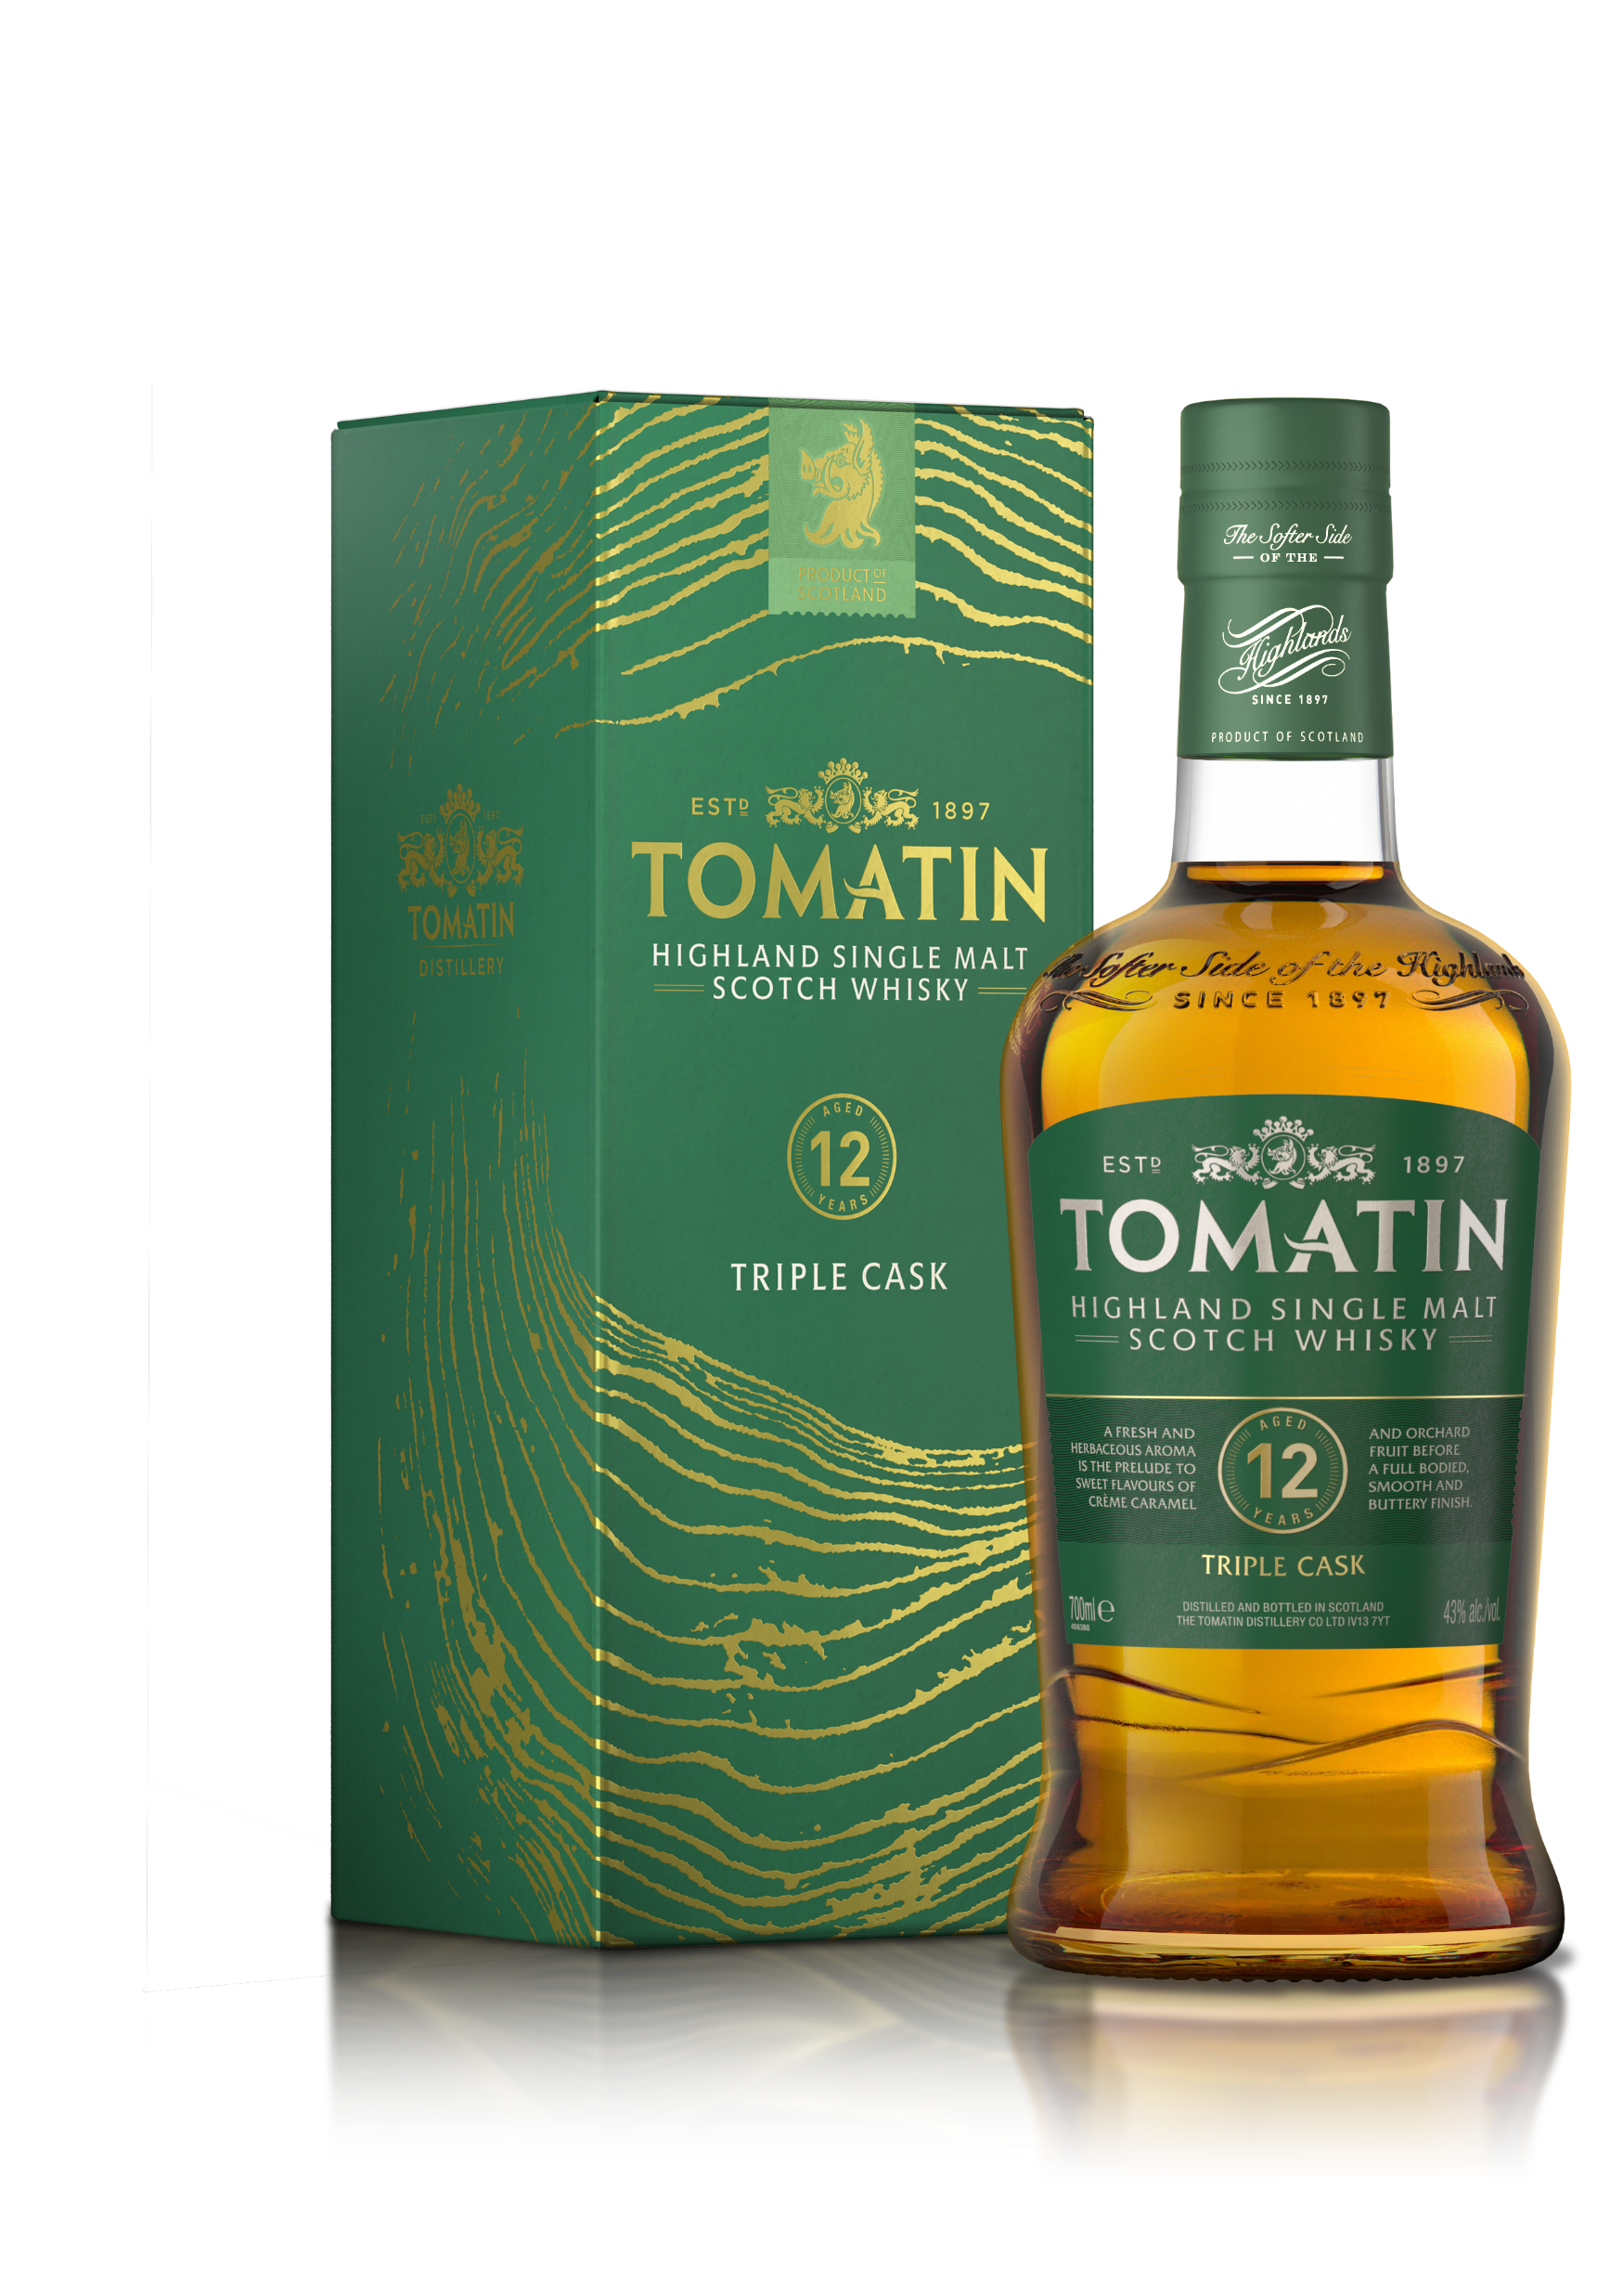

Tomatin 12 Year Old Triple Cask
The Tomatin 12 Year Old is smooth and silky, having been matured in traditional Scotch Whisky, ex-Bourbon and ex-Spanish Sherry casks. A rich, fruity aroma is the prelude to sweet flavours of ripe apples, pears and a subtle hint of nut before the long, pleasantly oily finish.
TRIPLE CASK
51% - Ex-bourbon
32% -Ex-sherry
17% - Refill
ABV Strength: 43% alc./vol.
Available stock:
Promotional pricing:
Key Details:
Rare use of Virgin Oak creates a modern
Flagship product of the range
Smooth and easy drinking
Triple wood maturation -use of ex-Bourbon, ex-Sherry and refill casks creates a very traditional style of Highland Single Malt
Consistently award-winning for many years
Gold in the 2021 San Fransico World Spirits Competition

