Slide 1
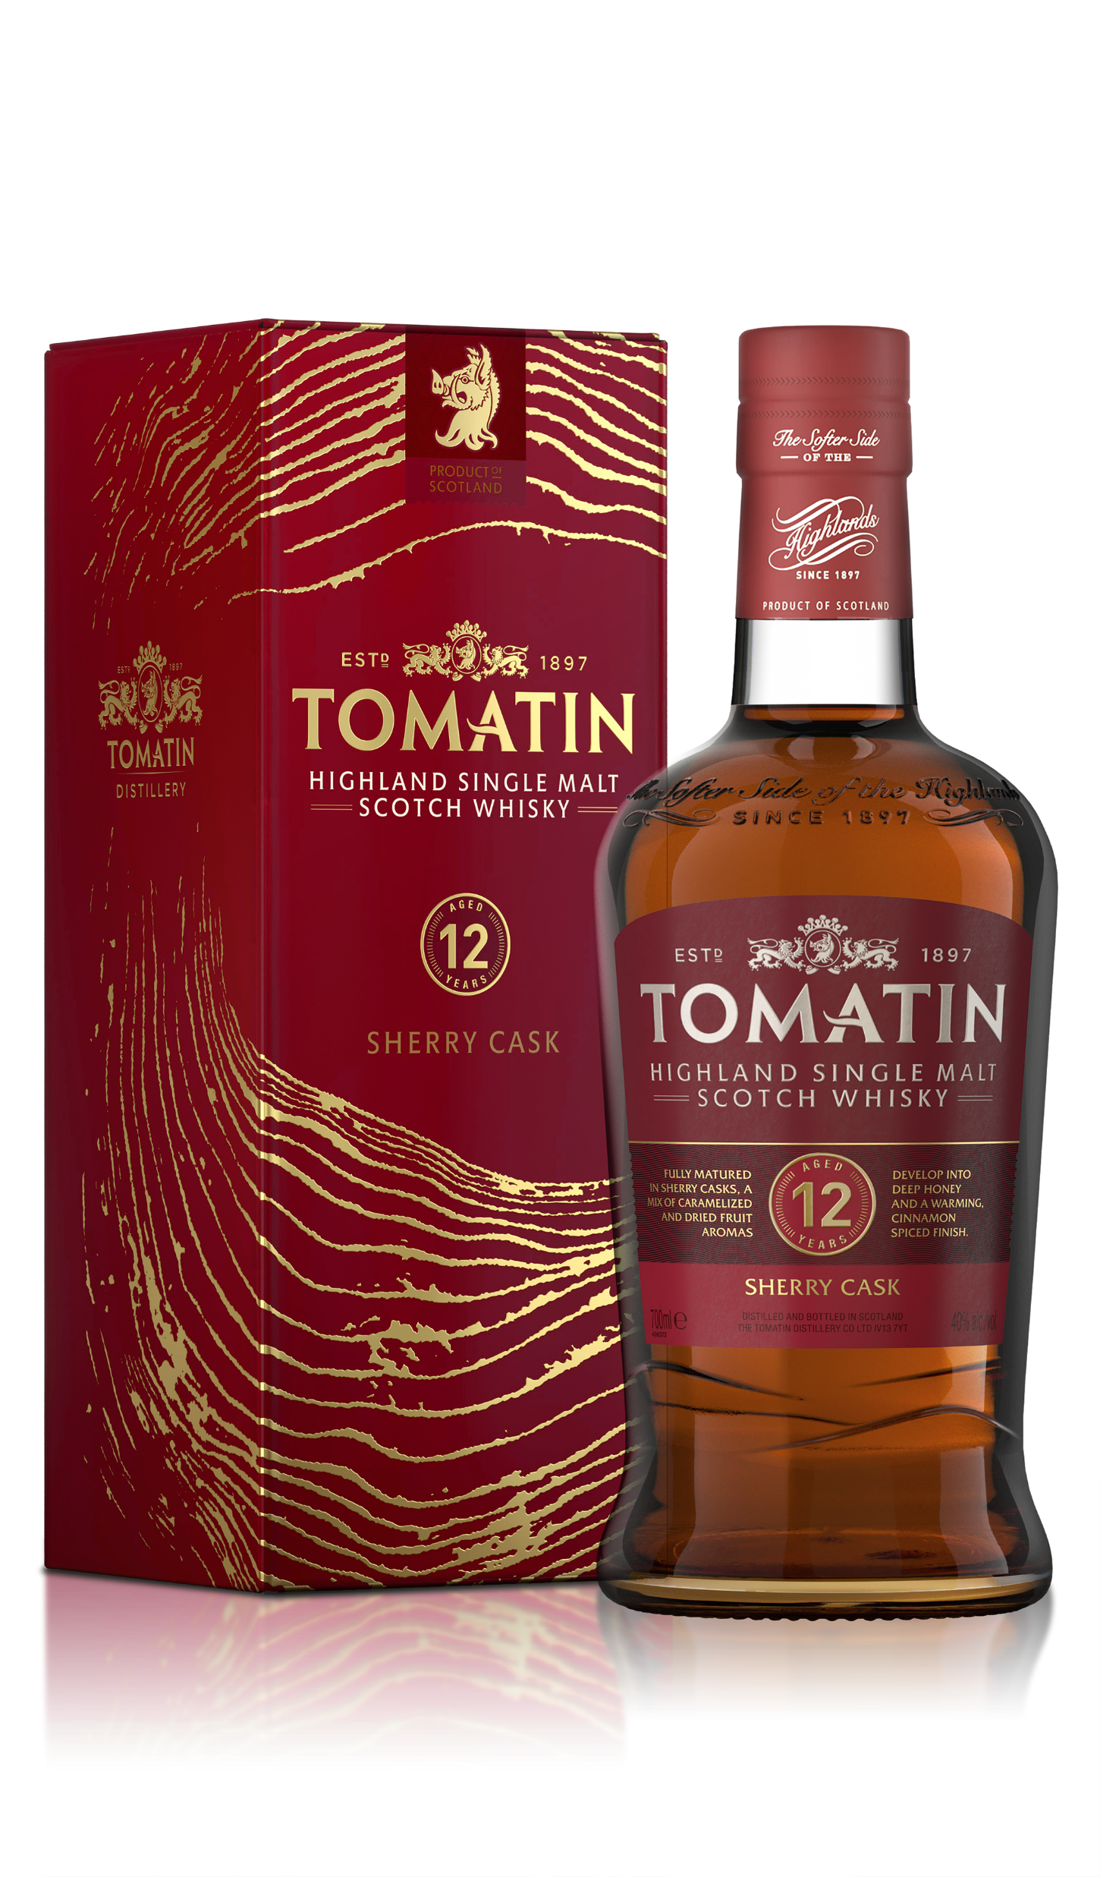

Tomatin 12 Year Old Sherry Cask
Fully matured in Sherry casks for 12 years, this Tomatin Single Malt is packed full of rich, decadent flavours. Caramelised apple and pear lead, balanced with a wonderful mix of sultana, orange peel, apricot and hints of aged leather. Deeper on the palate with notes of chocolate fudge and manuka honey, along with dried fruit and nut. The finish is warm and round with a sweet, cinnamon spice.
SHERRY CASKS
ABV Strength: 40% alc./vol.
Available stock:
Promotional pricing:
Key Details:
FULLY MATURED IN SHERRY CASKS
Smooth and easy drinking, heavily sherried single malt bursting with flavour
New addition to the Tomatin range 2024
Developed for placement in specialist spirits retailers

