Slide 1
Notes:
The Antiquary has changed.
For the past five years, we have been working on rebuilding its once great name and evolving our ethos to create something truly distinctive. In its re-invention we have both honoured our history and been future focused. Antiquary is a curator of great whiskies for those who are curious and eager to explore. The complexities, creativity and invention involved in building a great blended whisky are often underestimated and undervalued. Once seen as the pinnacle of Scotch whisky we believe the art of blending should be celebrated and honoured.
This is the story of The Antiquary re-awakening.

Slide 2
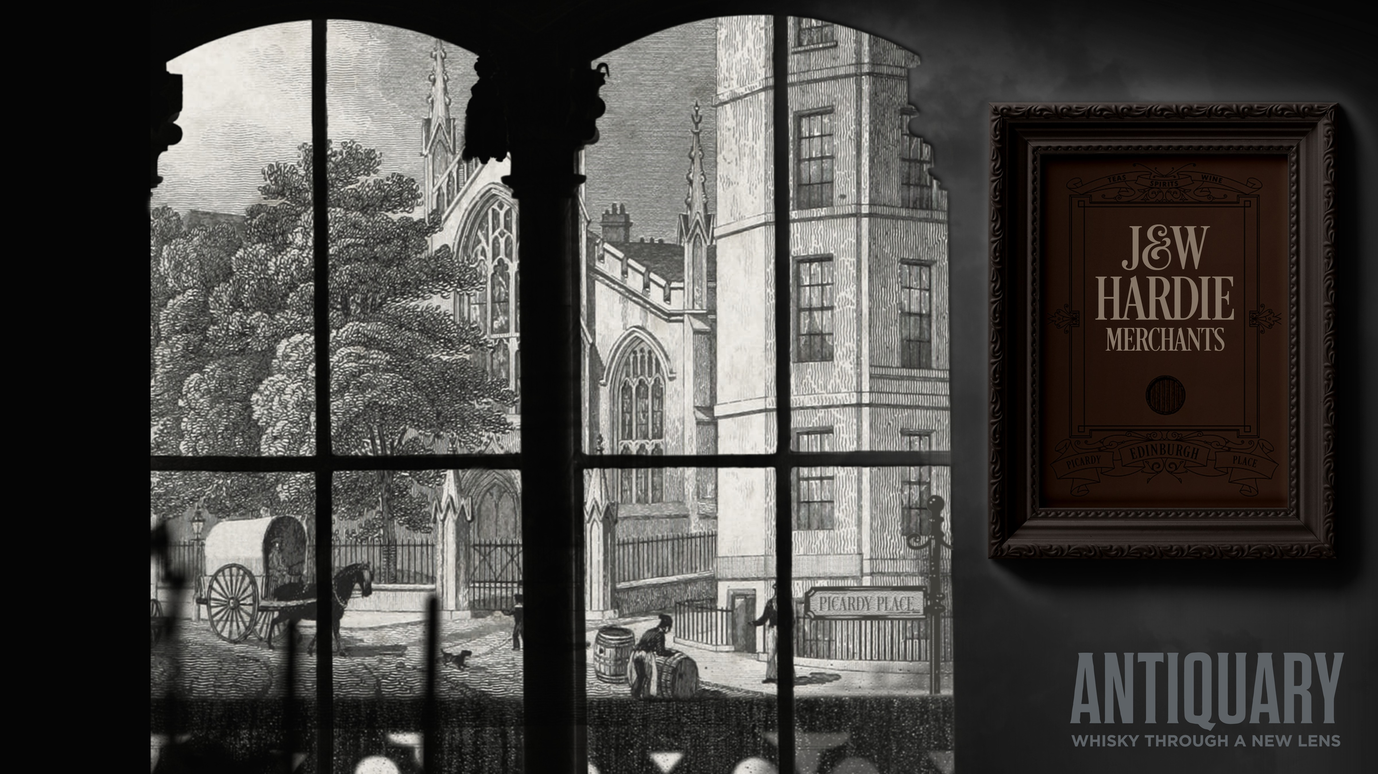
Notes:
In 1859, John and William formed J&W Hardie Merchants in Picardy Place, Edinburgh. Their focus was tea, wines and spirits, booming categories in the fashionable New Town of Edinburgh.
On mainland Europe, the Phylloxera bug was decimating the wine and brandy production. The British Empire under, Scotland's greatest fan, Queen Victoria was creating enormous demand for deluxe Scotch whisky.

Slide 3
Notes:
In 1888, J&W Hardie Merchants in Edinburgh, created ‘The Antiquary’. A deluxe whisky, they unashamedly “charged a little more” for its quality.
The Hardie’s had a flair for marketing, naming The Antiquary after Sir Walter Scott’s famous novel.
In 1917 they sold the brand to Distiller’s Company Ltd who were master brand builders and progressive in their approach to advertising. In the 60’s they created the distinctive diamond shaped bottle. A revolution of its time.
In 1996, DCL sold The Antiquary to The Tomatin Distillery. With Single Malt booming we naturally focused on building Tomatin, meaning The Antiquary took a back seat.
Everyone at Tomatin recognised the gem we held and were eager to see its revival.

Slide 4
Notes:
Scott, our young blender, was briefed to explore the vast portfolio in our warehouses and to both pay homage to our past and create whiskies for a new generation
He researched the Hardie archives, their whiskies and the casks they would have used. He also investigated the flavours and styles that would have been popular at the time.
But he didn’t just create a pastiche. He put his own style and personality into creating three whiskies that reflected the history of Antiquary, but that appeal to people like him. Self-expressionists who love to put their own twist on history.
A blend of rich malts from the Highlands and Speyside along with grain whisky from North British distillery. After blending, he laid the whisky down for long marriages in wine, port and sherry casks.

Slide 5
Notes:
We took a similar approach to packaging and presentation. The bottle, inspired by crystal antiques of the Victorian and Edwardian eras has a contemporary stylish twist using sharp branding and lines.
Antiquary puts changing perceptions, self-expression and flair through the lens.

Slide 6
Notes:
The Single Malts used are a collection of fine and rare Highland and Speyside whiskies and they have been blended with the characterful and sumptuous North British Single Grain. Once blended they were then poured into red wine claret casks from the Bordeaux region in France and given a long period to marry before bottling. Scott selected these casks because they are a reflection of the wine casks our founders would have imported back in the 19th century.
NOSE: Mahogany, polished leather, pipe tobacco, candied orange, grilled peaches and cloves
PAL ATE: Rhubarb, tamarind, raspberry coulis and vanilla
FINISH: Medium with warming fruit jam

Slide 7
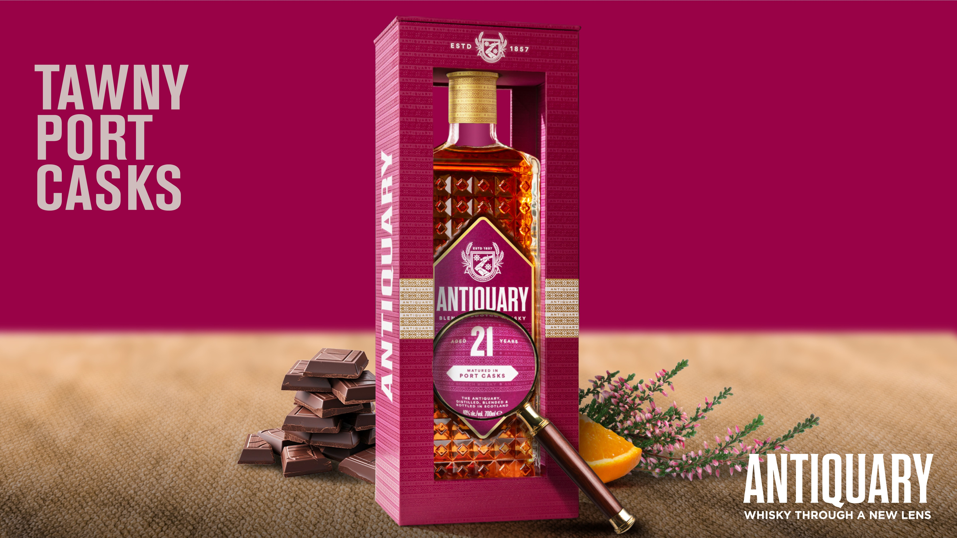
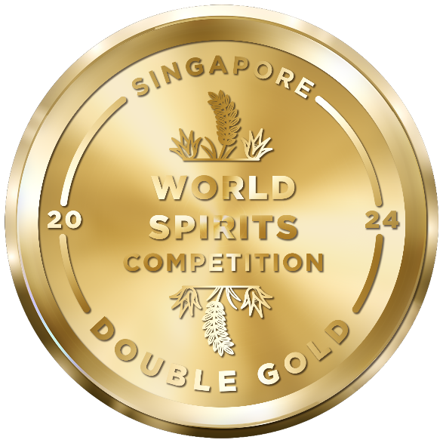
Notes:
The Single Malts used are a collection of fine and rare Highland and Speyside whiskies and they have been blended with the characterful and sumptuous North British Single Grain. In the 21YO, Scott has included some peated Single Malts to reflect the Antiquary style of the 60’s & 70’s, when the brand was at its peak.
Once blended they were then tipped into Tawny port casks from the Symington family estates in Portugal and then left to marry, for three years, before bottling. Scott selected these casks because they are both a reflection of the casks our founders would have imported back in the 19th century and because Port brings a sumptuous and rich character to whisky.
But don’t just take our word for how great this whisky is. It won a double gold at the prestigious Singapore World Spirits Competition in 2024.
NOSE: Camphor, hessian, cut hay, burning heather, dark mocha, Saffron and vanilla
PAL ATE: Spiced plum, wild strawberries, dark chocolate, charred game and orange
FINISH: Sea salt and red fruits

Slide 8
Notes:
The Single Malts used are a collection of fine and rare Highland and Speyside whiskies and they have been blended with the elegant North British Single Grain. Once blended they were then poured into Sherry casks from the Jerez region of Spain and then left to marry, for three years, before bottling. Scott selected these casks because they are both a reflection of the casks our founders would have imported back in the 19th century and because Sherry casks typically deliver heavier and full-bodied flavours, ideally suited to whiskies with a long vintage.
NOSE: Passionfruit, mango, grilled pineapple, maple syrup, hints of smoked bacon and aged timber
PAL ATE: Tropical fruit, syrup and rich oak spice
FINISH: Beeswax, heather honey and waxy tropical fruitiness

