Slide 1
Notes:
The Antiquary has changed.
For the past five years, we have been working on rebuilding its once great name and evolving our ethos to create something truly distinctive. In its re-invention we have both honoured our history and been future focused. Antiquary is a curator of great whiskies for those who are curious and eager to explore. The complexities, creativity and invention involved in building a great blended whisky are often underestimated and undervalued. Once seen as the pinnacle of Scotch whisky we believe the art of blending should be celebrated and honoured.
This is the story of The Antiquary re-awakening.

Slide 2
Notes:
The Single Malts used are a collection of fine and rare Highland and Speyside whiskies and they have been blended with the characterful and sumptuous North British Single Grain. Once blended they were then poured into red wine claret casks from the Bordeaux region in France and given a long period to marry before bottling. Scott selected these casks because they are a reflection of the wine casks our founders would have imported back in the 19th century.
NOSE: Mahogany, polished leather, pipe tobacco, candied orange, grilled peaches and cloves
PAL ATE: Rhubarb, tamarind, raspberry coulis and vanilla
FINISH: Medium with warming fruit jam

Slide 3
Notes:
The industrial revolution in the 1800’s brought great prosperity to Scotland and Edinburgh.
The British Empire was on the rise, offering opportunities for vast wealth's to be created. It’s an age of entrepreneurial activity breading invention and experimentation.
This is when James Hardie, in 1827, moved to Edinburgh and set up as a merchant. He was joined by his twin brother, Robert to form J&R Hardie Tea, Wine and Spirits Merchants.
Their older brother, Joseph, produced a whisky called ‘Hardie’s Whisky’ and it is highly likely that James and Robert sold this as part of their range.
Following the death of Robert, James’s first bourn child, John, joined the business as an apprentice to support his father, at the age of 15.

Slide 4
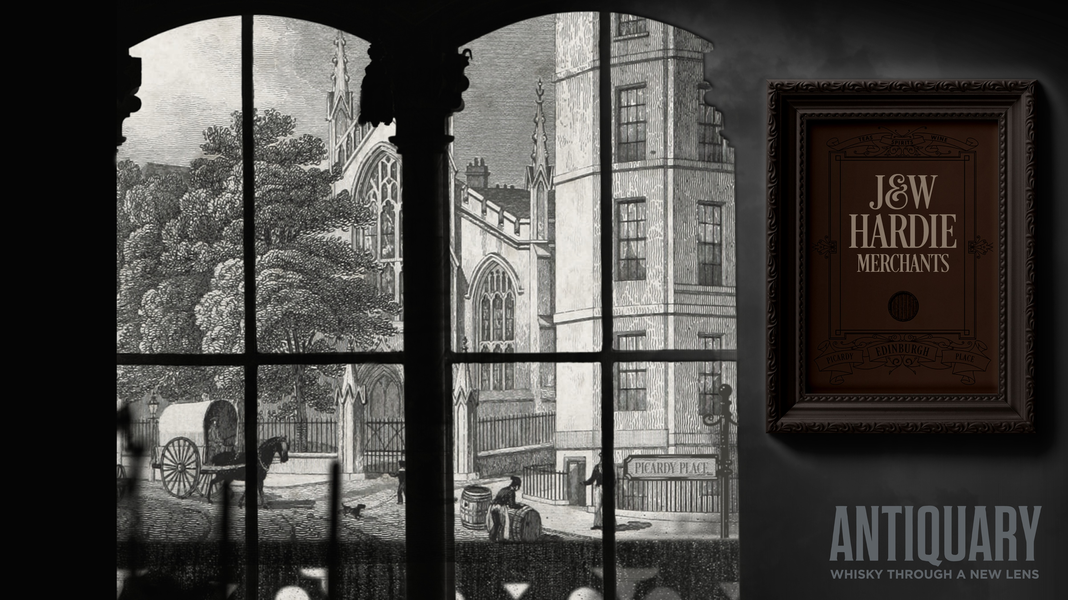
Notes:
John learned quickly and, at only 22, he already had seven years of experience under his belt.
So, with the typical can-do attitude of his family, he set up as a merchant with his brother William joining him in 1859.
These clearly ambitious and self-determined young men settled in to their 4 Picardy Place premises, in Edinburgh, forming J&W Hardie Merchants.
Their focus was tea, wines and spirits, which were booming categories in a new Victorian era at the heart of the fashionable new town area of Edinburgh.

Slide 5
Notes:
The British empire had made tea both available and very popular. Fortunes were there to be made.
John and William became very successful tea blenders and developed sophisticated noses and pallets to produce superior and popular tea blends.
These skills would give them an advantage in other areas of their business and its future enterprises.

Slide 6
Notes:
Alongside their tea operations, the brothers grew their wines and spirits business. Their refined palates were able to select the very best products from around the world.
And, by the mid-1870s, the brothers were agents for De Laage Fils Cognac, St. Marceaux Champagne, and Mackenzie Port and Sherry, amongst others.
By 1883 they were also the agents for the prestigious Balblair distillery.
At the same time, on mainland Europe, the Phylloxera bug was decimating vineyards and, as a result, wine and brandy production. This, alongside the growth of the British Empire under, Scotland's greatest fan, Queen Victoria created an enormous demand across the globe for deluxe Scotch whisky.
It is clear that J&W Hardie’s were a major players in the luxury market serving the great and good of the Victorian era.

Slide 7
Notes:
In the mid 1800’s, Scotch Whisky was changing, thanks to the invention of the continuous column still by Aeneas Coffey.
This ingenious invention brought several benefits to the industry including lower costs, higher output, less maintenance and a greater level of consistency.
It also produced a lighter, cleaner spirit which, when mixed with traditional single malt whiskies, produced an elegant, sweeter and easy drinking blend.
So, merchants and shop owners like Johnnie Walker, John Dewar and our very own Hardie Brothers saw the opportunity to provide their customers with a more consistent and easier to drink whisky.
It also gave them the opportunity to put their own marque on what they sold.
In the west, around Glasgow, merchants such as William Teacher were creating bold smoky blends. And in the East, around Edinburgh, whisky makers like our own Hardie brothers preferred more gentle and elegant taste profiles.
Combining their tea blending skills, with their knowledge of the wines and spirits market, by 1880 the brother’s had become actively involved in blending whisky and launched their first Scotch, branded ‘Edina’. Labelled as “Very Fine Old Highland Whisky… Full Proof, Matured in Sherry Wood”, the new brand expanded beyond Scotland and, as this advert shows, they became significant exporters to the Empire.
As the number of brands that the brothers represented grew so too did the business and by 1888 they started Hardie Brothers Wine Merchants, firmly establishing their credentials in the drinks industry.

Slide 8
Notes:
As whisky became an increasingly important part of the brother’s business, sourcing quality grain whisky was vital to continue their growth. Up until this point there was a bit of a monopoly in grain whisky production, with Distillers Company Limited owning all of the distilleries in Scotland.
To break this dominance, a collection of blenders and merchants decided to build a new grain whisky distillery in Edinburgh. John and William were part of this bold move and became founding shareholders in Edinburgh’s North British Distillery in 1887. This is a giant of the Scotch industry even today and supplies many of the leading blenders in Scotland. Ironically, North British is now owned by Diageo, which evolved from Distillers Company Limited.

Slide 9
Notes:
Typical of the era, long trips on steamers to far flung parts of the world selling and promoting their wears were part of the job. It would be fair to say that this was a more glamorous time to be a whisky salesman.
William Hardie (featured here with his glamours wife) is listed as a “Commercial Traveller”. Clearly the driving force behind its global success.
Sadly, John died not long after The Antiquary launched, but his son James, joined the business and over the following 20 years He and his uncle built the Antiquary brand to become a huge success.
A business directory from 1905 notes: “The taste for "Antiquary" whisky is becoming, every year, more widely disseminated in distant quarters of the globe increasing quantities being exported by the proprietors to the US, Argentina, China, India, Egypt, Canada, Australia and SA”.
It is clear that whilst John was the mastermind behind the whisky, William was the one who made it an international success. A great partnership.

Slide 10
Notes:
With a solid source of quality whiskies, the brothers expanded their range in 1888, when they launched ‘The Antiquary’. Presented as a deluxe whisky, they unashamedly “charged a little more” for the quality it delivered.
By this time, they had gained huge experience in the drinks market and in blending. So, they were able to bring together their knowledge flavours, casks, maturation and blending to create this spectacular blended scotch.
Like many of the great whisky blenders of the time, the Hardie’s had a flair for marketing. For example, The Antiquary was named after the third of Sir Walter Scott’s Waverly novels.
Although Scott died in 1832 his work, as part of the romanticisation of Scotland, continued to be popular throughout the 19th century; he became Scotland’s answer to Shakespeare. By associating with this highly popular book, the Hardie Brothers stole an advantage on their competition.
Beyond naming and advertising, the brothers were adept guerrilla marketers and would anonymously visit hotels in Europe and ask for a measure of The Antiquary. When the bartenders said they’d never heard of it the Hardie boys would act astonished and claim it was “all the rage in London”.

Slide 11
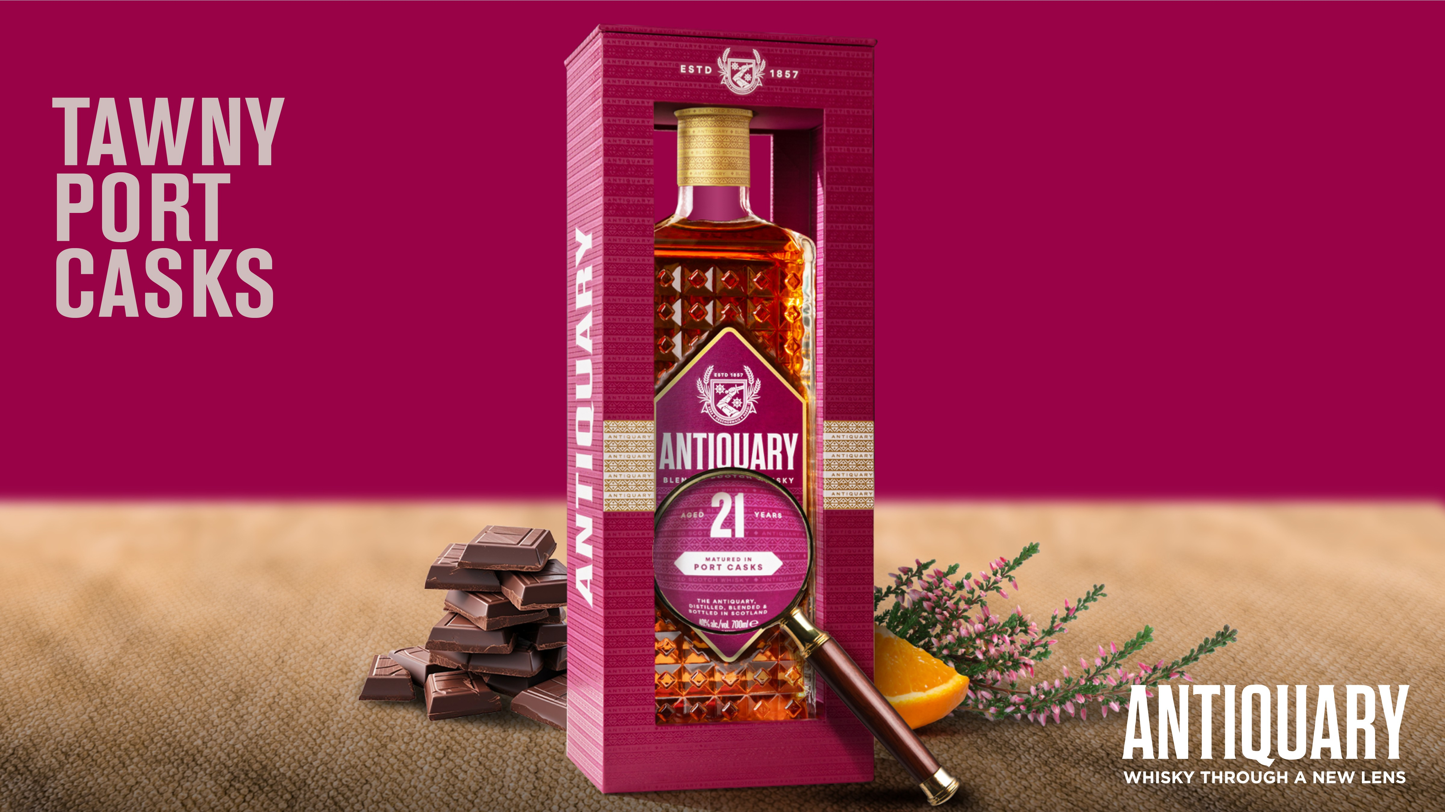
Notes:
The Single Malts used are a collection of fine and rare Highland and Speyside whiskies and they have been blended with the characterful and sumptuous North British Single Grain. In the 21YO, Scott has included some peated Single Malts to reflect the Antiquary style of the 60’s & 70’s, when the brand was at its peak.
Once blended they were then poured into Tawny port casks from the Symington family estates in Portugal and then left to marry, for three years, before bottling. Scott selected these casks because they are both a reflection of the casks our founders would have imported back in the 19th century and because Port brings a sumptuous and rich character to whisky.
NOSE: Camphor, hessian, cut hay, burning heather, dark mocha, Saffron and vanilla
PAL ATE: Spiced plum, wild strawberries, dark chocolate, charred game and orange
FINISH: Sea salt and red fruits

Slide 12
Notes:
James went on to run J&W Hardie following the passing of his father and uncle, continuing their legacy.
But in 1917 James sold ‘The Antiquary’ brand to J&G Stewart which was taken over a year later by the Distiller’s Company Ltd. DCL went on to become the massive drinks giant Diageo.
DCL were master brand builders and, were very progressive in their approach to advertising, employing the polymathic artist, Tomi Ungerer to produce a range of highly distinctive adverts in the early 1960’s to support the brands American expansion.

Slide 13
Notes:
They continued to build the brand, making it a global success story. Overtime they changed the name from The Antiquary Liqueur Scotch’, a term used for upmarket blends, to ‘The Antiquary De Luxe’ in the 1940s.
Then in the 1960’s a unique design was created and the diamond shaped bottle was launched. A revolution of its time.
In the 1990’s DCL began negotiations for the creation of Diageo and it became clear that they would have to give up some of their leading blended scotch whiskies.
So, in 1996 J. & W. Hardie, along with The Antiquary brand was sold to The Tomatin Distillery Co. Ltd. Tomatin was a huge supplier of whisky to the blended scotch market. Indeed, during the 60’s and 70’s, it had been the worlds largest whisky distillery. But with few brands in its stable, buying a prestigious deluxe brand like Antiquary was a good fit.
But, over the following decades blended scotch became a saturated category dominated by huge brands, both in terms of brand investment and in competitive retail prices.
At the same time, the Single Malt Scotch Whisky renaissance started to take place. People were becoming increasingly curious about new flavour and whisky styles, which the huge variety in single malt whiskies offered.
As an independent whisky distillery, Tomatin naturally focused on building its single malt. But this meant The Antiquary took a bit of a back seat.
Whilst this once famous brand continued to be popular in Spain, the UK and South America sales declined and costs increased.
Availability of whisky for blending became more of a challenge because distillers could achieve higher prices selling their whisky as single malts. At the same time mainstream blend brands were becoming more commoditised and, it the prestigious Antiquary struggled to compete in this very challenging market.
So, its one-time status as a leader in the category and a globally recognised prestigious brand faded.
However, everyone at Tomatin recognised the gem we held in The Antiquary. We often heard people saying “my father or grandfather used to love a bottle of that for special occasions, like Christmas”
We were eager to see a revival of the glory days for our brand.
But we knew that emulating other blended scotch whiskies was not going to work. We need to find our own style. Think differently and so work began on re-inventing The Antiquary for a new generation.

Slide 14
Notes:
Whilst Tomatin is a small independent distillery we are fortunate to have rich collection of incredibly high-quality whiskies from around Scotland.
Because our Distillery was once the biggest in the world, and produces such an amazing spirit, other whisky makers are eager to trade with us. This is known as the reciprocals market in Scotch, and it has enabled us curate a beautiful collection of mature whiskies.
A great arsenal to work with when re-defining The Antiquary.

Slide 15
Notes:
Having decided to revive The Antiquary, and bring a new angle to whisky, it was time to work on the whisky.
Meet Scott, our young master blender. At a spritely 33 years old he brings fresh thinking to our whisky innovation and as such, was in the perfect position to look at Antiquary through a new lens.
The brief for Scott, was to get experimental, be curious about where he could take Antiquary. In addition, he should-
Explore the vast portfolio in our warehouses
Both pay homage to our past and create whiskies for a new generation
Make quality and flavour his goal
Keep the batches small and precious

Slide 16
Notes:
As graduate of history, Scott used his research skills to examine the J&W Hardie archives. He studied the Hardie brothers, the type of whiskies and casks that they would have had access to at the time of creating Antiquary.
Getting to know how their business operated and what made them successful, Scott was able to get a feel for the whisky they produced.
As we have seen, our merchants of wines, ports and sherry’s, had huge experience in the array of flavours and characters that could be achieved in wine.
He also investigated the flavours and styles that would have been popular at the time, again to help influence the style of whiskies that he would create.

Slide 17
Notes:
Scott was also inspired by the types of casks our founders would have used in the 19th century.
They would also have had ready access to great quality casks, from their suppliers.
At the time, wine casks would also have been used extensively in the maturation of whisky, as European wines were far more accessible, geographically, than American Bourbon.
Whilst we are often fixated by the maturation benefits that casks bring to whisky, it is worth remembering that they were used extensively just for convenient storage.
When holding whiskies in the premises much of it would have been stored in casks and when preparing their whiskies, it is likely that our founders blended them long before they were ready to bottle. This would have resulted in it marrying for extended periods of time.

Slide 18
Notes:
But Scott didn’t just want to create a pastiche of the past. As an enthusiastic historian, he has a deep respect for the past, but also believes in putting his own style and personality into his work.
Scott created three whiskies that reflected the history of Antiquary, but that would appeal to people more like him. Self-expressionists who love to put their own twist on history.
Determined that the complexity of the malts would come to the fore, he gave the Antiquary an unusually rich malt content at 40%
He searched through our inventory to find great quality Highland and Speyside whiskies
Then he insisted on sourcing out brilliant quality grain whisky and, of course, it had to come from the North British distillery, again respecting the heritage of the brand and the Hardie brothers
The final piece of the whisky making puzzle was to allow the selected whiskies to get to know one another. So, he laid the blend down for unusually long marriages. Where most brands are blended and then bottled almost straight away, by giving the newly created blend time back in the cask, the collection of whiskies have time to mingle and combine in a more subtle way. This is called marrying, and we don’t just do it for a few weeks or months, we opt to leave it resting for years.
And for the marriage, he selected casks that would both add to the character and pay homage to the brands history.
So he selected-
French wine casks
Portuguese Port casks
Spanish Sherry casks
All of which the Hardie brothers would have used in abundance.

Slide 19
Notes:
The Single Malts used are a collection of fine and rare Highland and Speyside whiskies and they have been blended with the characterful and sumptuous North British Single Grain. Once blended they were then poured into Sherry casks from the Jerez region of Spain and then left to marry, for three years, before bottling. Scott selected these casks because they are both a reflection of the casks our founders would have imported back in the 19th century and because Sherry casks typically deliver heavier and full-bodied flavours, ideally suited to whiskies with a long vintage.
NOSE: Passionfruit, mango, grilled pineapple, maple syrup, hints of smoked bacon and aged timber
PAL ATE: Tropical fruit, syrup and rich oak spice
FINISH: Beeswax, heather honey and waxy tropical fruitiness

Slide 20
Notes:
In unison with Scott’s thinking, we briefed our designers to take a similar approach to packaging and presentation.
The bottle was inspired by crystal antiques of the Victorian and Edwardian era’s but with a contemporary stylish twist using sharp branding and lines to accentuate the vintage style.
Along with our packaging, the presentation of the brand nods to history, but with a flare and style that reflects a modern age where people create their own image.
Antiquary puts changing perceptions, self-expression and flair through the lens. Hence the use of our diffusion lens in our advertising materials.

